Slide 1
The Matchmaker’s Dilemma
Predicting Tough Matches

Slide 2
90%
Proportion of adults who will be married at some point in their life
$2.23 Billion
Size of Online Dating market
66 Million
Estimate of Monthly Active Users on Tinder, most popular online dating app

Slide 3
The Problem
Matchmakers want to avoid making bad matches.
Using machine learning, we will attempt to identify these hard-to-place singles from the very beginning.

Slide 4


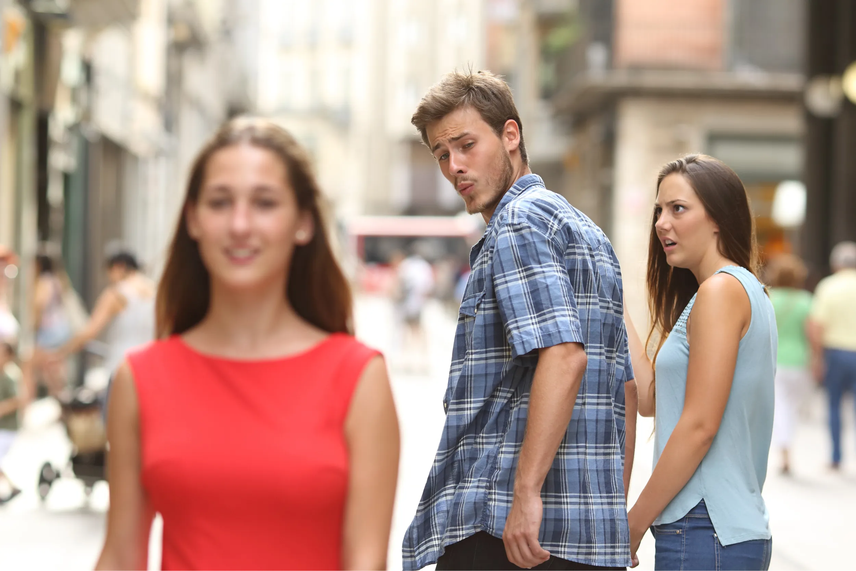




Stakeholders
Matchmaking services
Dating apps/sites
Eligible singles!

Slide 5
The Data
Marital Satisfaction Survey (2017)
7178 responses
30 variables
86 nulls, all same country/variable
Kansas Marital Satisfaction Survey
Measures overall satisfaction
3 variables
-3 (Very Dissatisfied) to 3 (Very Satisfied) scale (0 = neutral)
Demographic Data
Marriage and Relationships Questionnaire
Measures aspects of relationships
9 variables
-2 (No) to 2 (Yes) scale (0 = neutral)
GLOBE Survey
Assesses cultural attitudes of participants
8 variables
-3 (strongly disagree) to 3 (strongly agree) scale

Slide 6
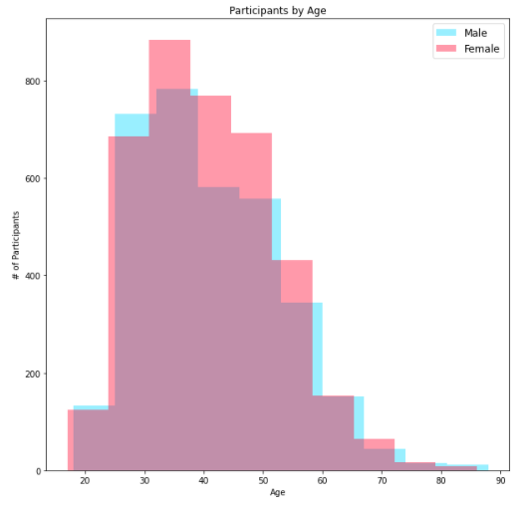
Demographics
Men and women from 33 countries
Represent a variety of religions, cultures, and education levels
All participants married at the time
Longest: 70 Years
Shortest: <1 year
Average: 14.8 years

Slide 7
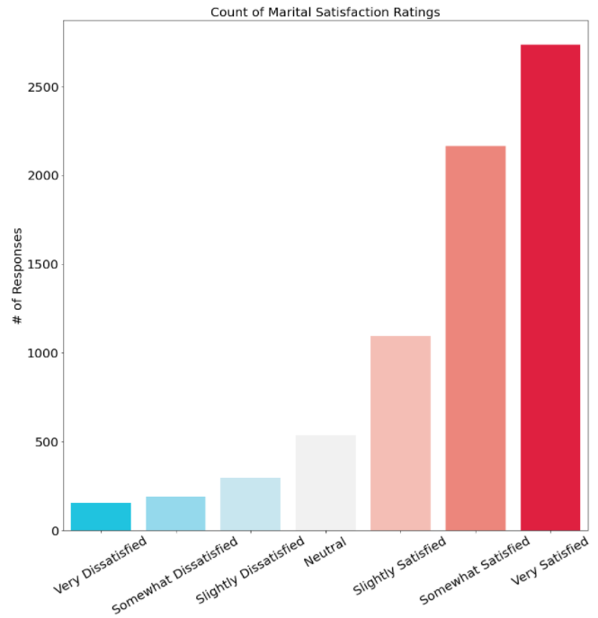
The Target: Marital Satisfaction
Great news!
But, a little lopsided...

Slide 8
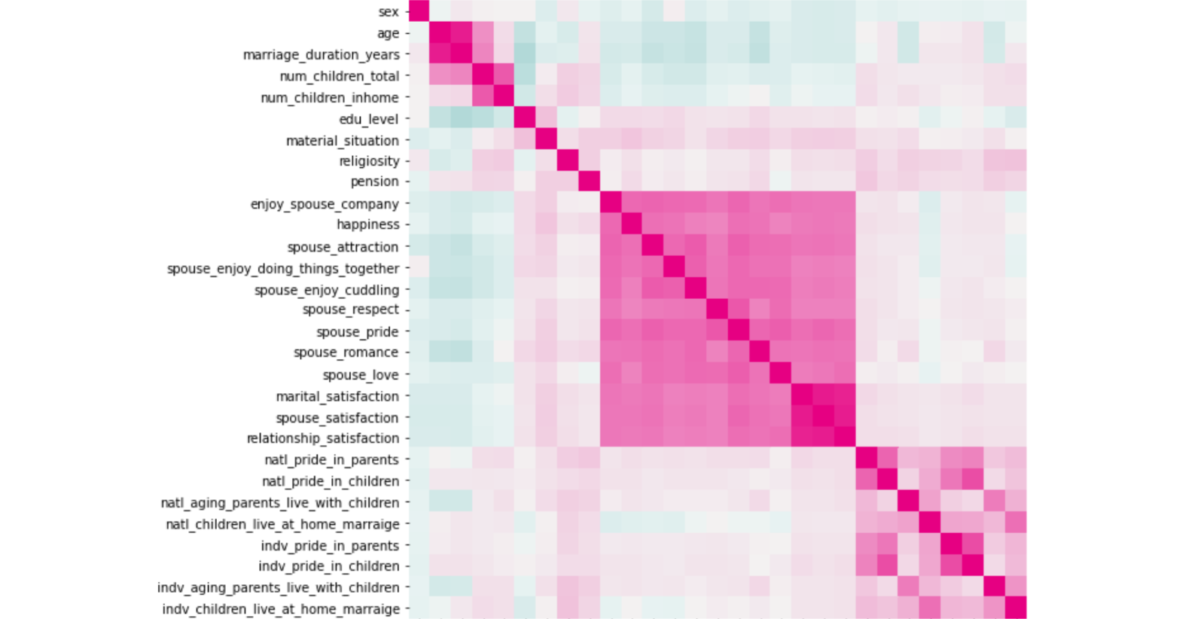
Regression Heatmap
MRQ
KMSS
GLOBE

Slide 9
Pre-processing
Converted marital_satisfaction into 0 (neutral and satisfied responses) and 1 (unsatisfied responses)
Converted nominal data sets to dummy variables
Dropped variables that were highly collinear with other variables

Slide 10
Model Training
Tested three binary classification models:
Logistic Regression
Random Forest Classifier
Support Vector Classifier (SVC)
Models were tested with best hyperparameters according to a Grid Search

Slide 11
Model Training
Algorithm | AUC Score | Parameters
Logistic Regression | .832 | C=0.01, L1_ratio=0.5, max_iter=5000, penalty='elasticnet', solver='saga'
Random Forest | .863 | max_depth=2, n_estimators=75
SVC | .793 | C=.001, probability= True

Slide 12
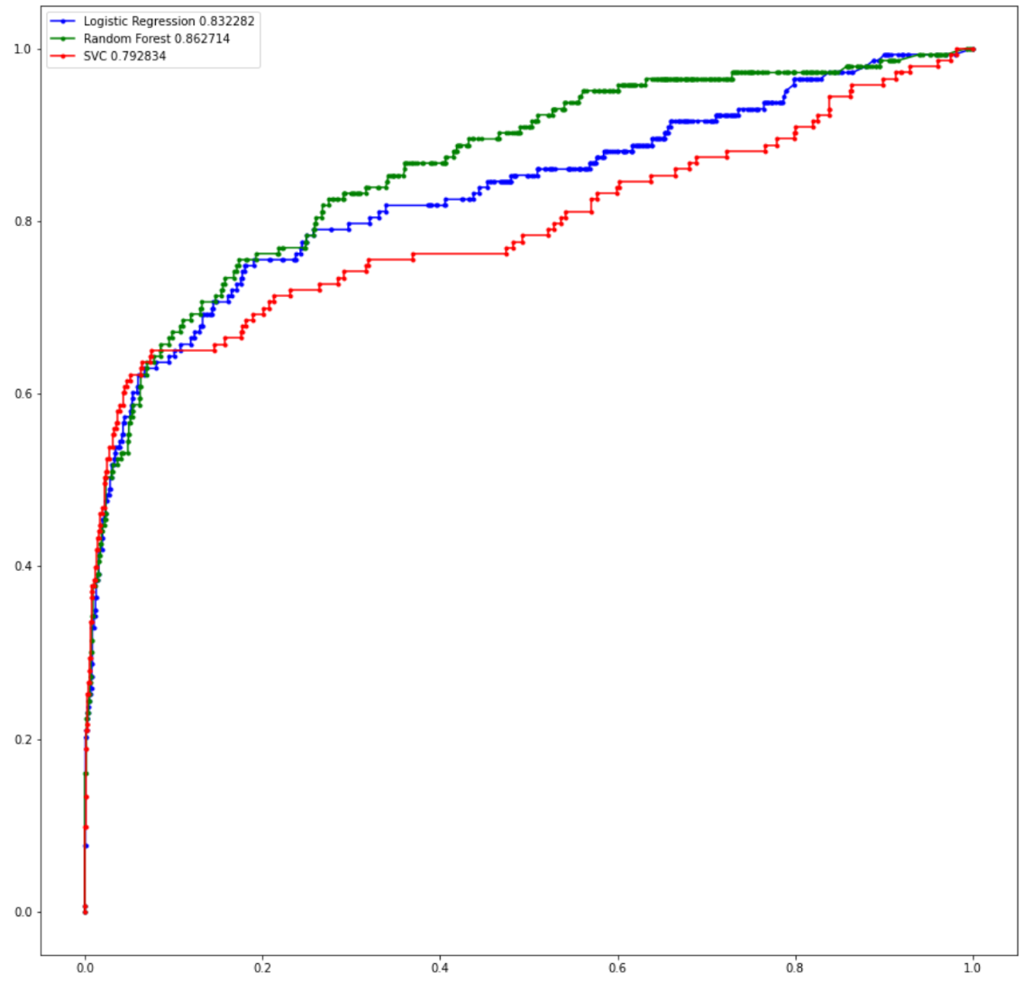

Slide 13
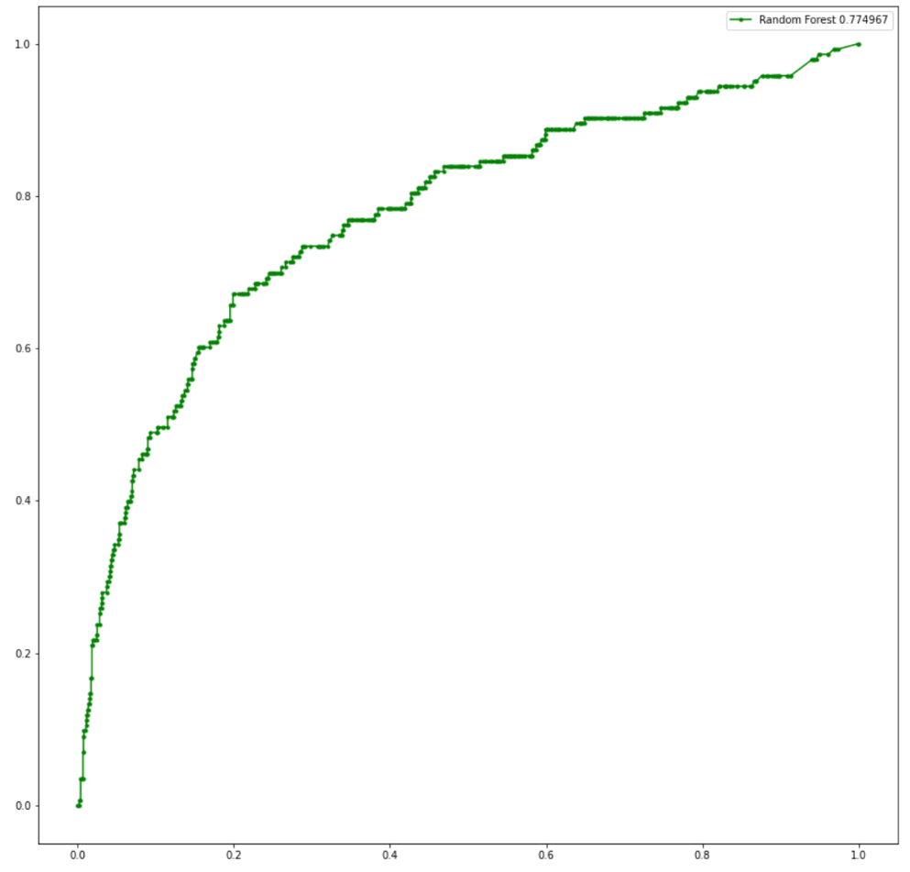
Feature Selection
Dropped measures of relationship quality that can’t evaluate single people
Reduced feature set to 6
Lower AUC score of .775, but better set of features

Slide 14
Thresholding
Tested different classification boundaries in order to improve on model
Threshold = .5 (default) | Predicted 0 | Predicted 1
Actual 0 | 1652 | 0
Actual 1 | 143 | 0
Threshold = .075 | Predicted 0 | Predicted 1
Actual 0 | 1221 | 431
Actual 1 | 47 | 96

Slide 15

Conclusions

